Slide 1
NRAC Resource Allocation Formula:
Purpose and Methods
Acute MLC sub-group: 4th February 2014

Slide 2
Outline:
Role of the formula
Basic overview of the issues
Structure, data and methods
Formula outputs

Slide 3
Purpose: to inform the distribution of around 70% of the health budget to 14 territorial boards ...
Through the calculation of target shares
Using estimates of predicted need
On an objective basis
To ensure equitable access to healthcare
Taking account of relative morbidity
And the relative (unit) costs of service
Notes:
Note that the formula is designed to look at need and not at the particular means (organisation or infrastructure) that boards may use to provide services to local populations: the mode of delivery is discretionary;

Slide 4



Basic overview: relative need
Health board A
Health board B
Notes:
Drawing on the NRAC stick people tradition to illustrate the basic issues;
Assume only two conditions needing care – fractures and pregnancy;
HB A population does not need healthcare;
HB B population needs healthcare;
This example is easy: board B gets all the money.

Slide 5
Basic overview: relative need
Health board A
Health board B
Notes:
Real populations are more complex;

Slide 6


Basic overview: relative need
Cost of fracture = £1,000
Cost of maternity services = £2,000
Notes:
Assuming these costs …
for treating a fracture …
and for providing ante natal and delivery care

Slide 7
Basic overview: relative need
Health board A: Cost = £4,000
Health board B: Cost = £5,000
Notes:
Yields these total costs per board …

Slide 8
Basic overview: relative need
Health board A: £4,000
Health board B: £5,000
Total £9,000
Target share: 44%
Target share: 56%
Notes:
Which (with some rounding) translates into the following shares;
Note that the total budget is not relevant to the formula: The relative shares are applied to the available budget.

Slide 9
Basic overview: predicted need
Budget allocated ex ante
But how many will require health care services …
??
??
Notes:
Need is always predicted need …

Slide 10
Basic overview: predicted need
Formula attributes health service use in the recent data to age, sex and socio-economic conditions – national average relationships
Need predicted by applying these national average relationships to local population characteristics and local socio-economic conditions
Notes:
2 step approach …

Slide 11
Structure:
Uses a weighted capitation approach
Fundamental starting point is (resident) population share
Weighted to reflect need for, and cost of, health services
Relative need: age and sex; Morbidity and Life Circumstances;
Relative cost: Unavoidable Excess Costs
Product of components generates target shares
Need
Population
Share
%
Age
& sex
index
Morbidity
& Life Cs
index
Excess
Cost
Index
Target
Share
%
X
X
X
=
Notes:
The basic approach is weighted capitation …
Main work done by the formula is to estimate the indices for the components;

Slide 12
Data:
Built up using small area information
Basic geographical unit is the data zone (or IG)

Slide 13
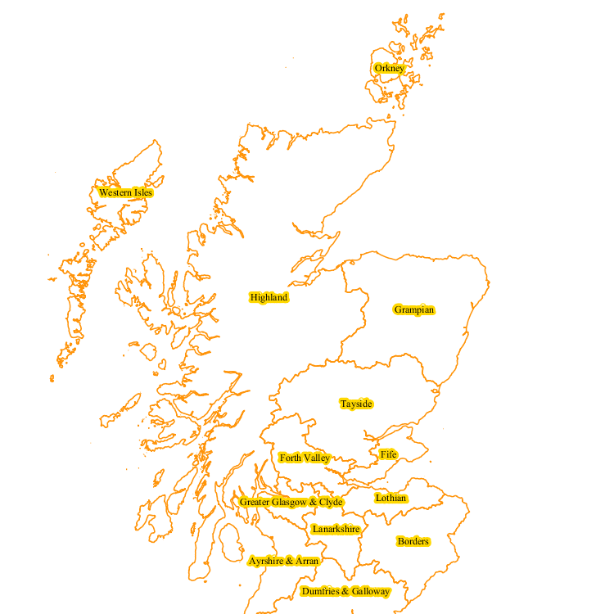
Health Boards:
Notes:
14 territorial health boards

Slide 14
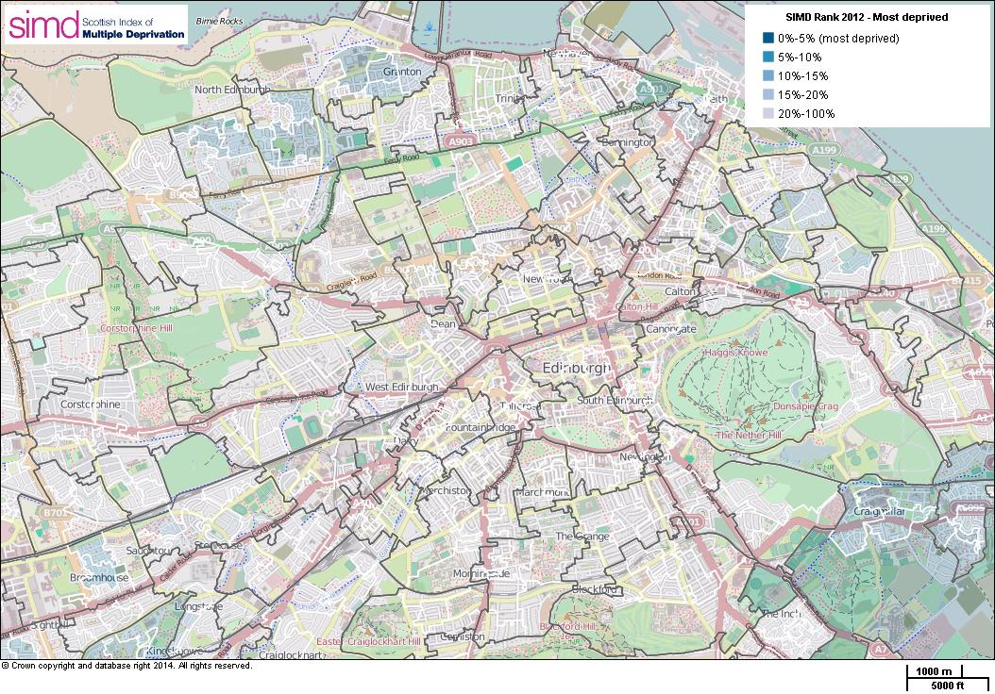
Notes:
The intermediate geography contains 1235 areas with each containing between 2,500 and 6,000 people

Slide 15
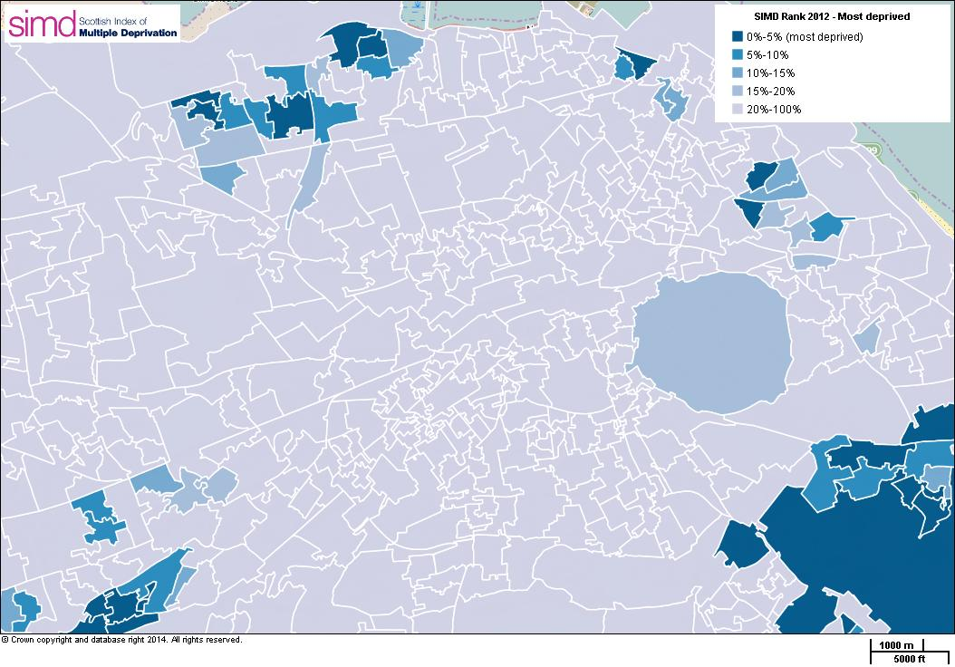
Notes:
There are 6505 data zones with populations of between 500 and 1,000 household residents

Slide 16
Data:
Resident population characteristics and socio-economic environment
NRS population projections – rebased
Need is modelled using healthcare utilisation (volume and cost)
SMR activity and Costs Book costs by speciality
Notes:
Note that because we use utilisation as the starting point there may be unmet need – to consider later
Scottish Morbidity Records give the DZ of residence, age, sex, speciality and hospital of treatment – which is related to the Costs Book expenditure by speciality by hospital.

Slide 17
Method:
Costing methodology
Episodes not spells
By care programme and diagnostic group
Notes:
Simple costing methodology – differs from the Scottish National Tariff and Glasgow and Lothian costing models;
There would be merit in having a consistent approach.

Slide 18
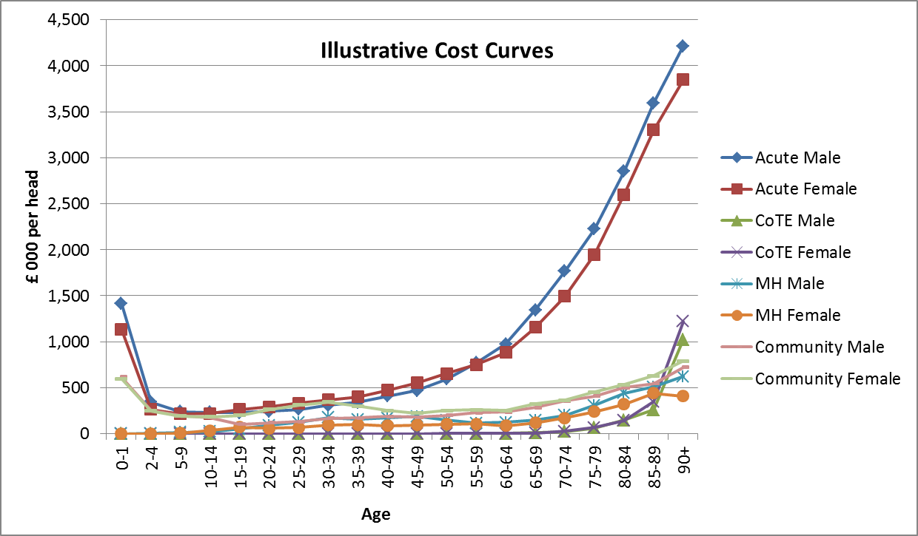
Method: age and sex effect
  estimated national average cost by age for males and females
Notes:
In the formula variation in the volume of utilisation by segmented into that which is related to age and sex and that which is not explained by age and sex;
The age and sex component is based on national average costs by sex and age cohort;
Note: does not take account of Proximity to Death effects …

Slide 19
Method: Morbidity and Life Circumstances
Morbidity and Life Circumstances effect captures the variation in utilisation relative to the age and sex effect
Measured by the cost ratio for the data zone
(Actual cost)/(Expected cost)
Scotland average = 1
Variation above or below Scotland average related to socio-economic indicators of need;
Analysis undertaken by diagnostic group
Notes:
So the age – sex effect tells us how much health care local populations would require if they had the national average need by age and sex – expected need;
The formula then considers the variation in local need beyond that related to age and sex i.e. when you have controlled for age and sex;
The data zone cost ratio is the actual cost relative to the expected cost (based on national age-sex factors applied to the local population age-sex composition) with both sets of activity costed at national unit costs.

Slide 20
Method: estimating the MLC effect
Age & Sex Adjusted Utilisation
 |  |  |  |  |  |  |  |  |  |  | x |  | x
 |  |  |  |  |  |  |  | x |  | x |  |  | x
 |  |  | x | x |  | x | x |  | x |  | x | x |  | x
 |  | x |  | x | x |  |  | x
 | x |  | x |  | x | x |  |  |  |  |  | x
 |  | x
Change in utilisation
1
Change in need
Socio-economic conditions
Notes:
The graph show a stylised scatter plot of this age-sex adjusted utilisation and the morbidity and life circumstances as represented by the socio-economic ‘indicators of need’;
Note that each cross represents a data zone and thus there should be around 6.5 thousand of them
The graph shows this utilisation expressed relative to the national average (= 1);
Where some local areas have utilisation above the average and some below;
What the formula does is to fit a statistical line (or function) through the data using regression analysis;
and the slope of the line captures the relationship between the change in the indicators of need and the change in utilisation;
Basically this line captures the predicted utilisation of health care (over and above age sex effects) given the particular characteristics of the data zone population.

Slide 21
Method: estimating the MLC effect
 |  |  |  |  |  |  |  | x
 |  |  |  |  |  |  | x |  | x
 |  |  |  | x |  | x |  | x | x
 |  |  |  |  | x |  |  | x
 |  |  |  |  |  | x
 |  |  |  |  |  | x
 |  | x |  | x
 |  | x
 | x |  |  | x |  | x
Utilisation
Socio-economic conditions
Notes:
Could be that predicted utilisation rises strongly with increased deprivation ()

Slide 22
Method: estimating the MLC effect
Utilisation
 |  |  |  |  |  |  |  |  |  | x |  | x
 |  |  |  |  |  |  | x |  | x |  |  | x
 |  | x | x |  | x | x |  | x |  | x | x |  | x
 | x |  | x | x |  |  | x |  | x |  | x | x
x |  | x |  | x | x | x
 | x
Socio-economic conditions
Notes:
Or more typically it rises modestly with changes in deprivation …

Slide 23
Method: estimating the MLC effect
Utilisation
 |  |  |  |  |  |  |  |  |  | x |  | x
 |  |  |  |  |  |  | x |  | x |  |  | x
 |  | x | x |  | x | x |  | x |  | x | x |  | x
 | x |  | x | x |  |  | x |  | x |  | x | x
x |  | x |  | x | x | x
 | x
Socio-economic conditions
Notes:
Should note that not all variation is included – there is also come random or unexplained variation …

Slide 24
Method: variation in (unit) cost …
‘Unavoidable Excess Cost Adjustment’
  Ratio of local unit costs relative to national unit costs
  DZ ratio averaged of across urban-rural geographies
  Objective geographical classification - control for variation in efficiency
Notes:
Finally the formula also adjusts for variation in unit costs across the country;
The adjustment refers to ‘Unavoidable’ excess costs because the formula tries to exclude inefficiency;
It does this by comparing local unit costs with national unit costs and averaging that ratio of local to national unit costs across individual urban-rural geographies

Slide 25
Outputs: Published Target Shares
Notes:
Shows how an individual board’s share develops as the different elements are applied …

Slide 26
Outputs: magnitude of variation in weights …
Age
& sex
index
Morbidity
& Life Cs
index
Excess
Cost
index
Overall
index
0.96 | 0.90 | 0.98 | 0.91
1.12 | 1.10 | 1.20 | 1.29
Health Board
0.52 | 0.71 | 0.97 | 0.41
2.07 | 1.85 | 1.38 | 2.18
Data Zone
Notes:
To give an indication of the magnitude of the variation across Scotland the slide shows the minimum and maximum indices for each of the components from the data published on the ISD website in respect of the 2013/14 target shares;

Slide 27
NRAC Resource Allocation Formula:
Purpose and Methods
Acute MLC sub-group: 4th February 2014

